Slide 1



The Grand Convergence: the Future of e-Learning and Education Publishing
Dr. Charles Severance
University of Michigan School of Information
Notes:
I am going to exaggerate at times to make a point.

Slide 2


In the Family...
Technology Faculty – University of Michigan
Brother – Math Faculty – Jackson CC
Brother – Credit Recovery - High School
Sister – Faculty – Washtenaw CC
Daughter – Special Ed K-5

Slide 3
Internet: TCI
Nuthin’ But Net
Richard Wiggins
1995
Notes:
Note the logo in the upper right photo.

Slide 4
Using Asynchronous, Web-based, Video to Humanize Distance Education
Richard Enbody & Charles Severance, Michigan State University
Submitted to: NSF/EHR/DUE CCLI-EMD Educational Materials Development 10/98
Notes:
In 1998 we wrote a grant that was basically streaming video content + activity stream for education – worked over 28.8 modems. NSF said the idea was "too obvious" and did not fund. Remember the name Richard Enbody – He was my thesis advisor – my thesis was about performance optimization and compiler techniques for HPC.

Slide 5
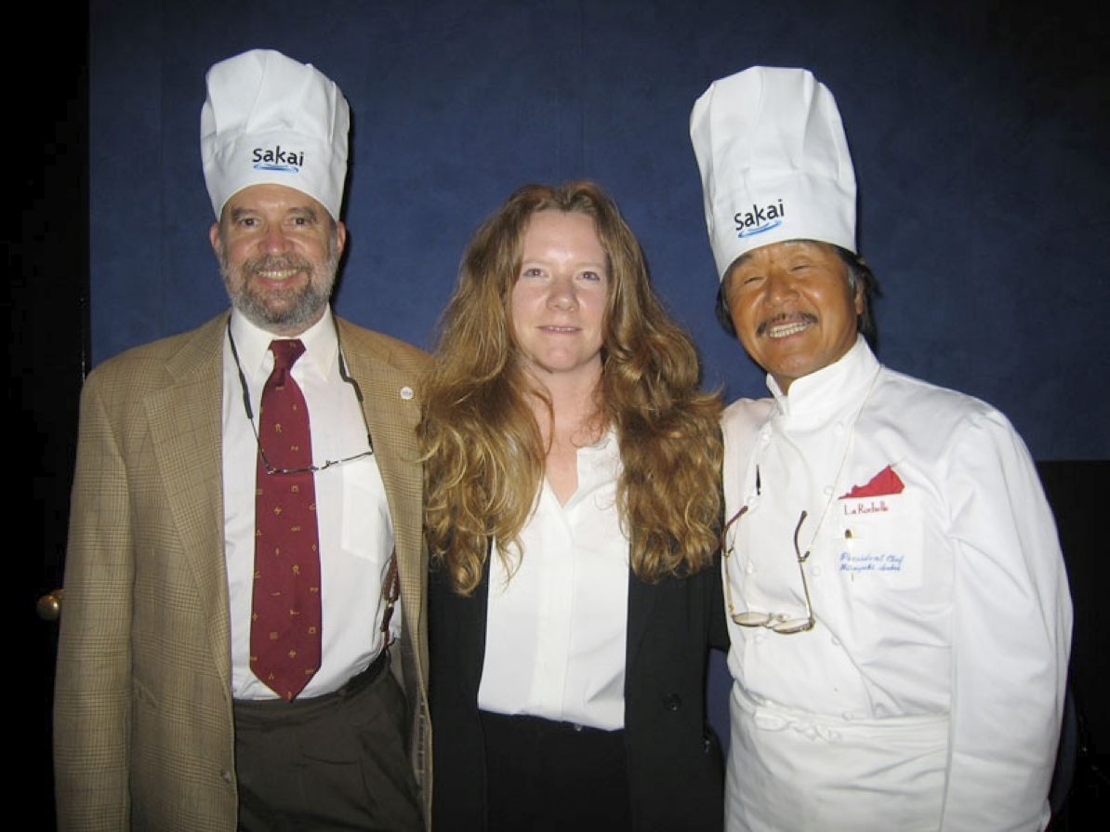



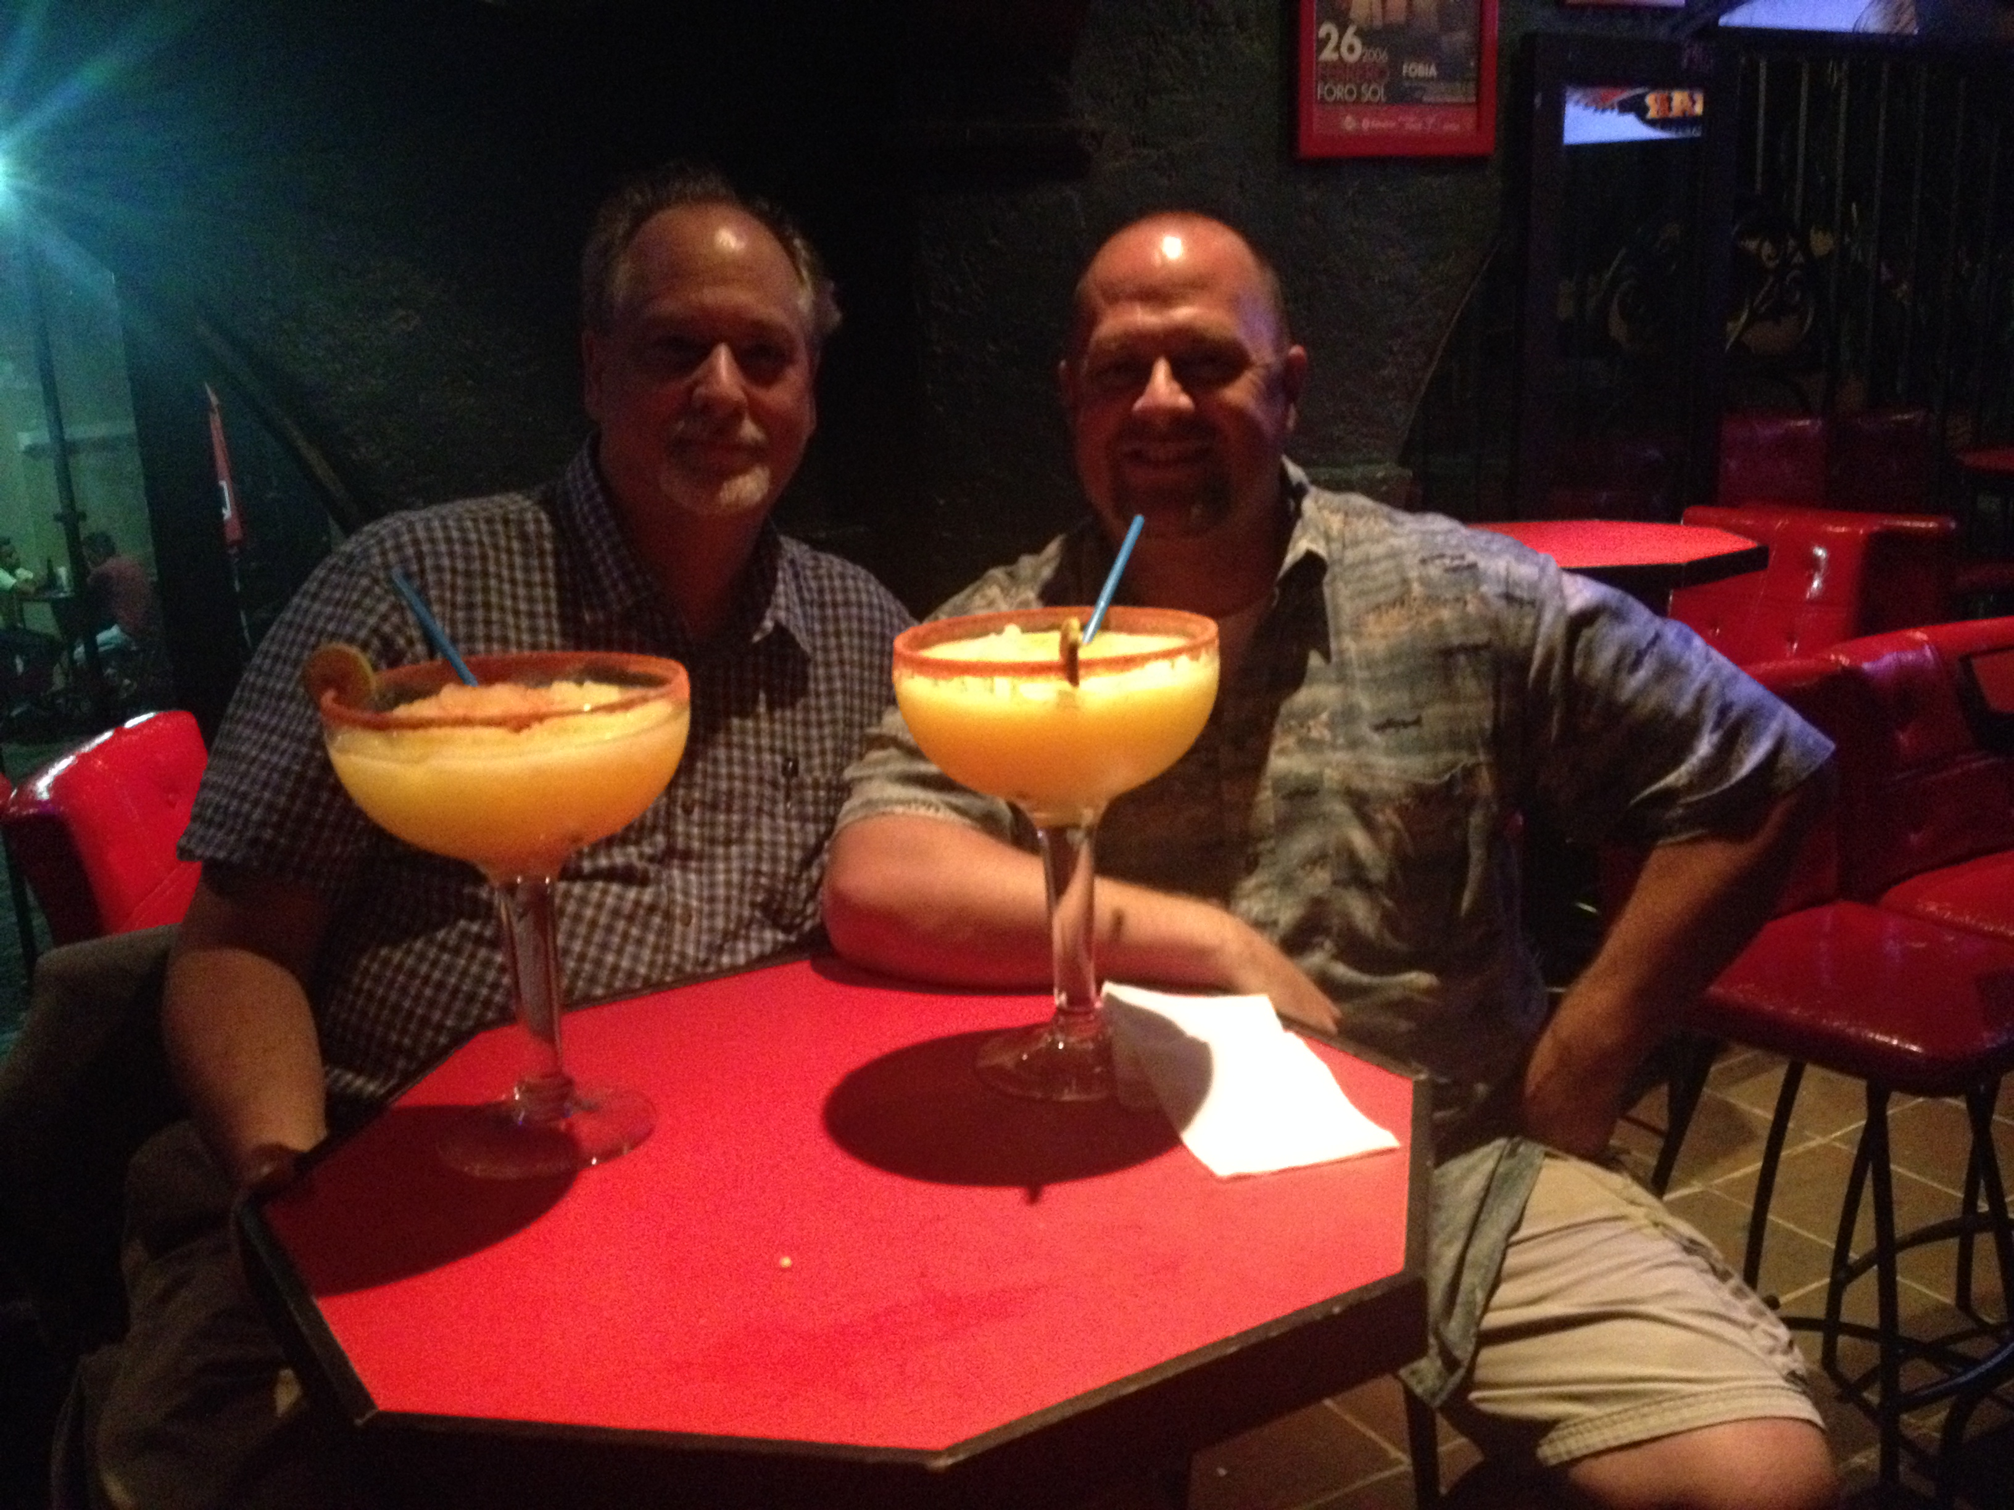
5

Slide 6


6

Slide 7
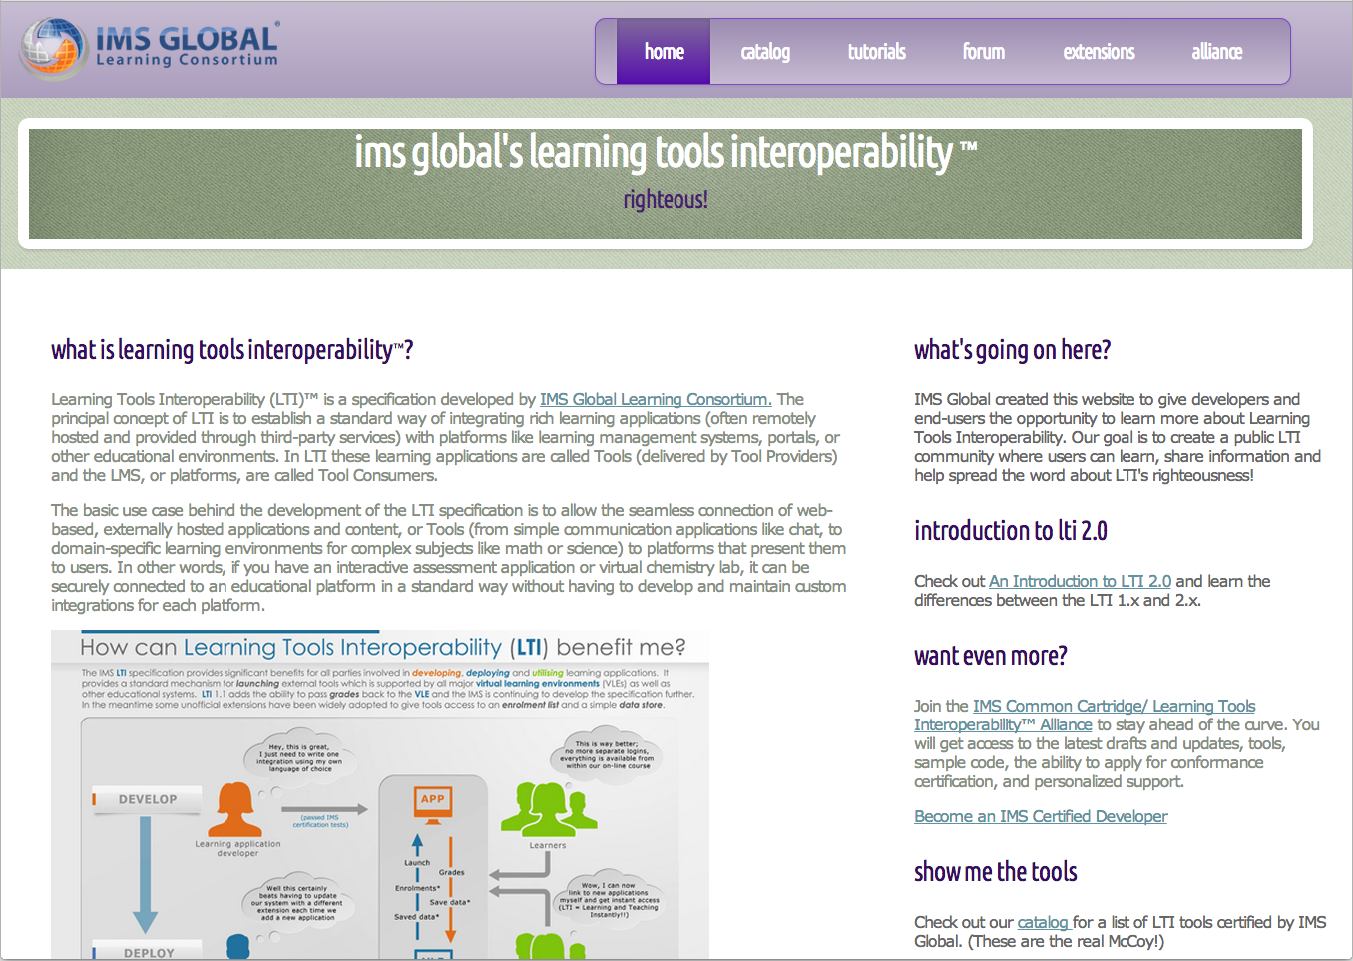

Notes:
Actually I do have a clue... Note Coursera logo.

Slide 8
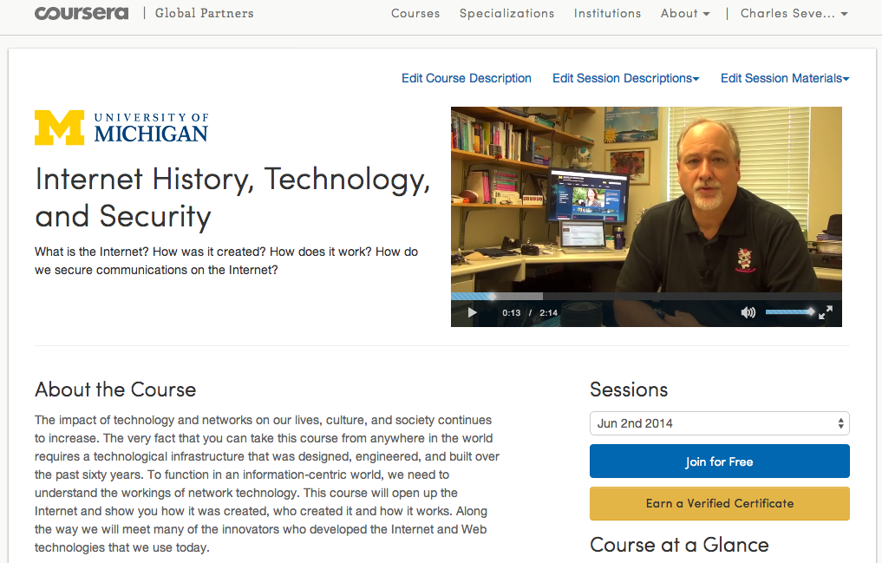

Slide 9
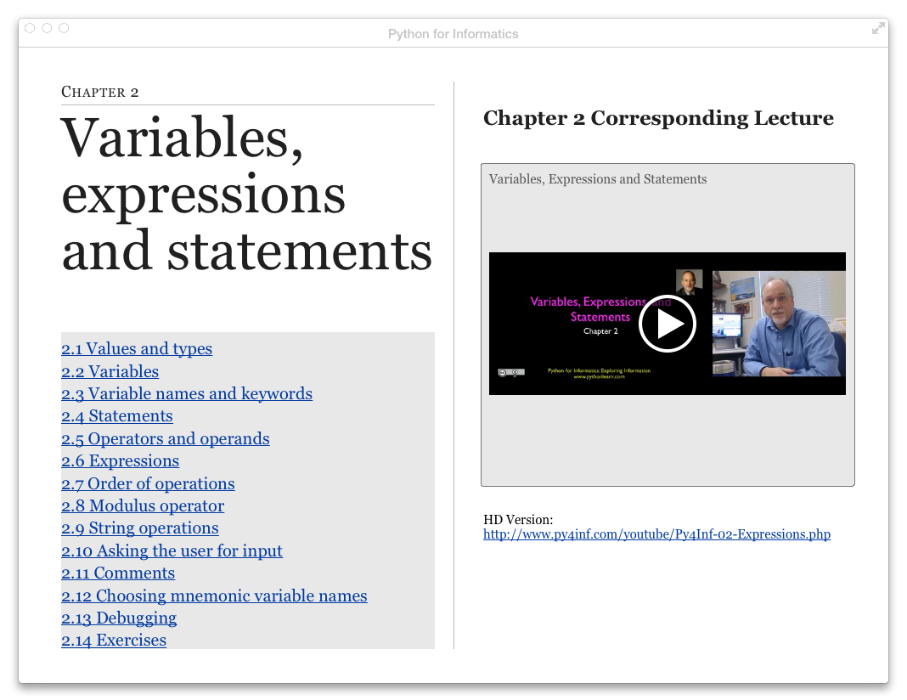
Notes:
I don't like proprietary.... I like open.

Slide 10
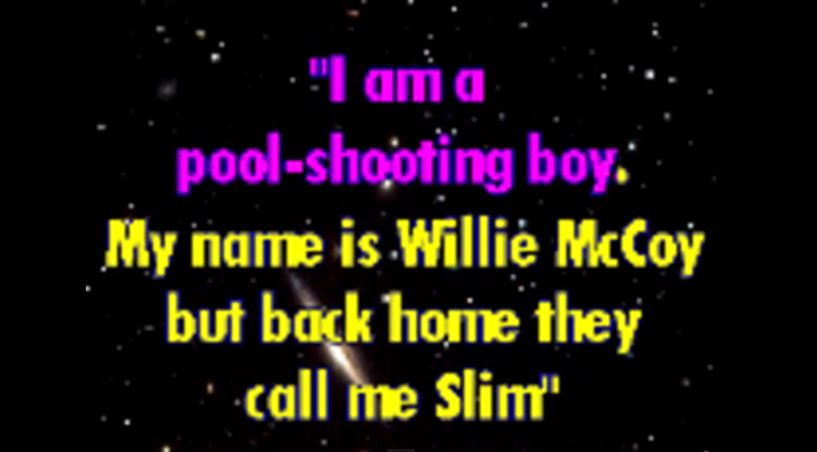
Notes:
I am looking for the king of 42 street he's driving a drop-top Cadillac.

Slide 11
Open Educational Resources
#fail

Slide 12
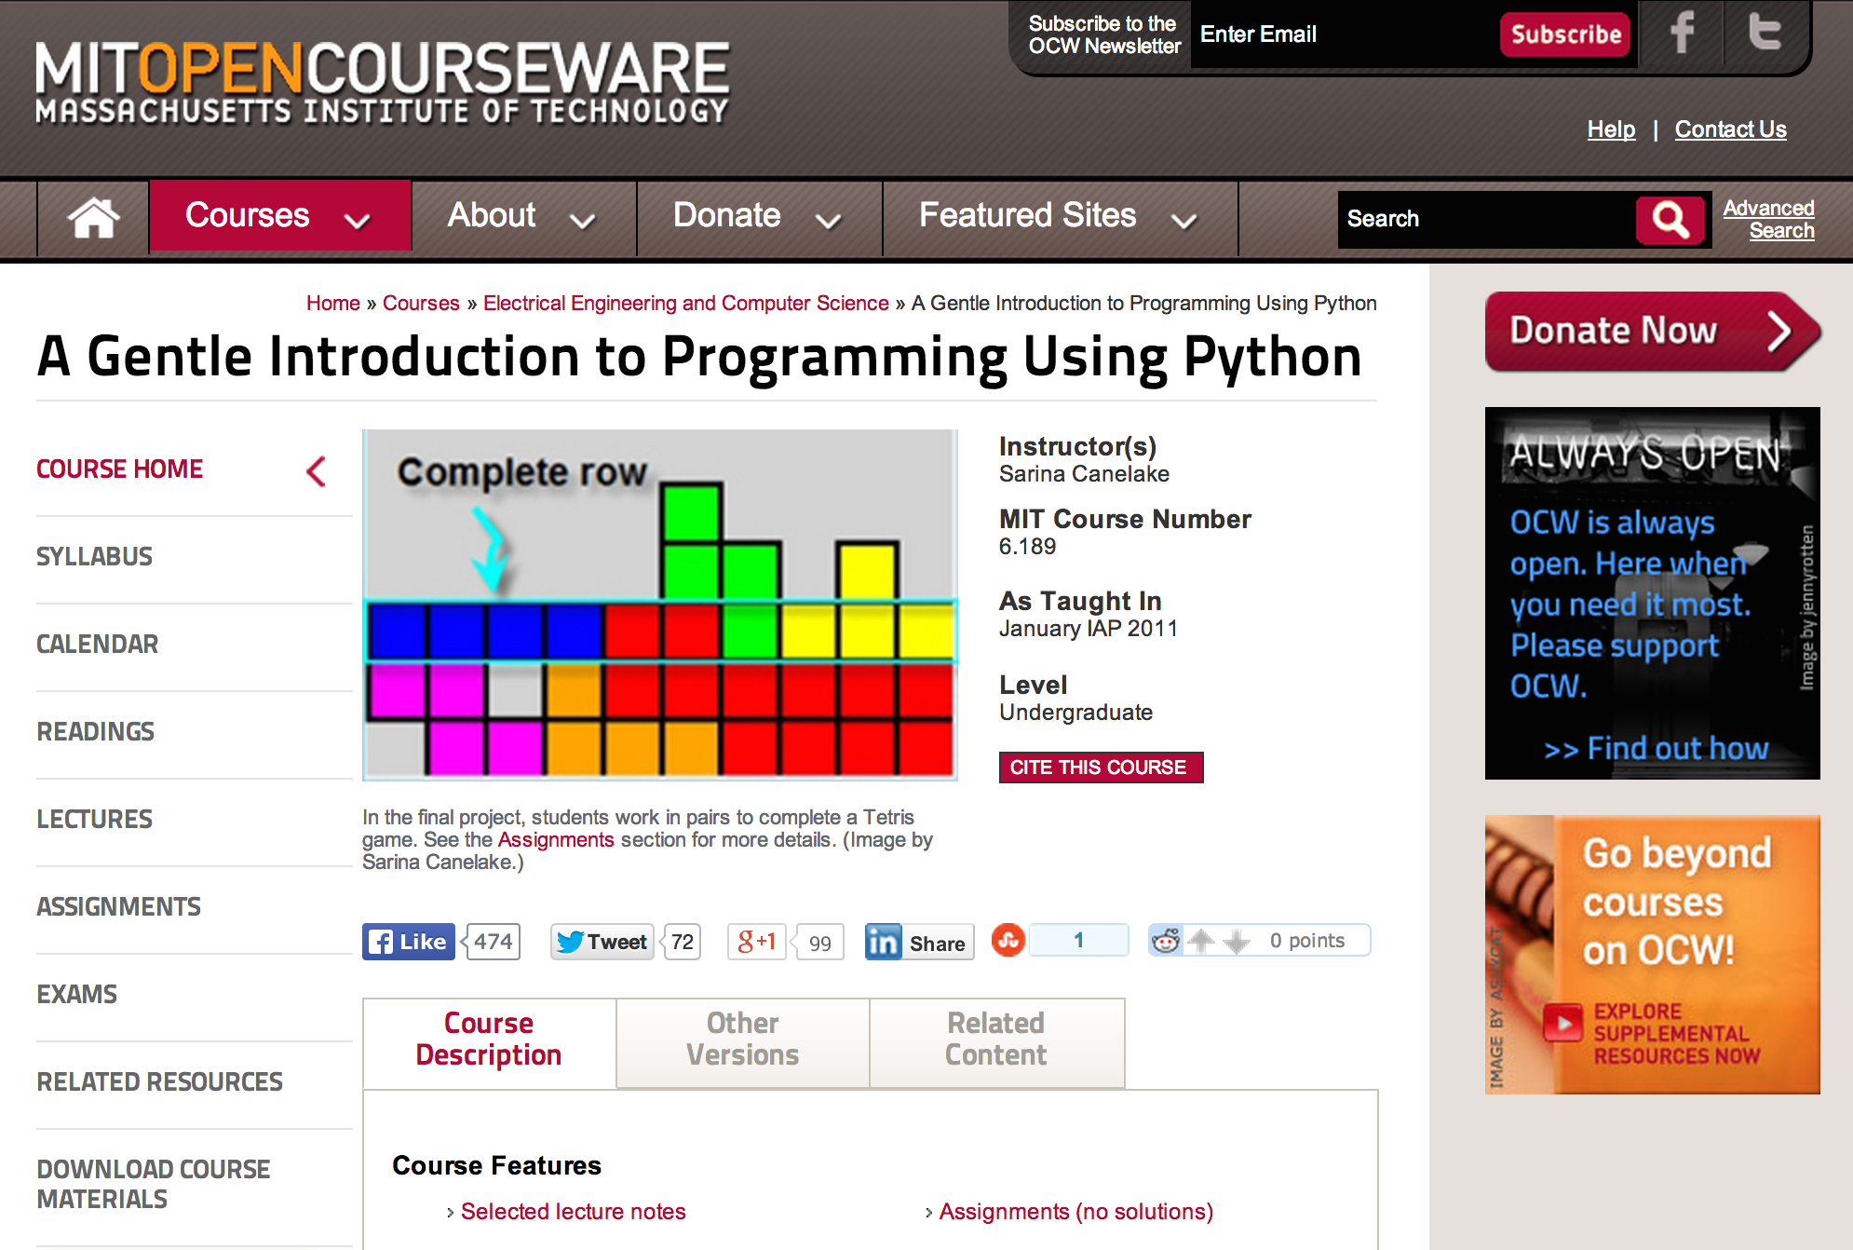

Slide 13
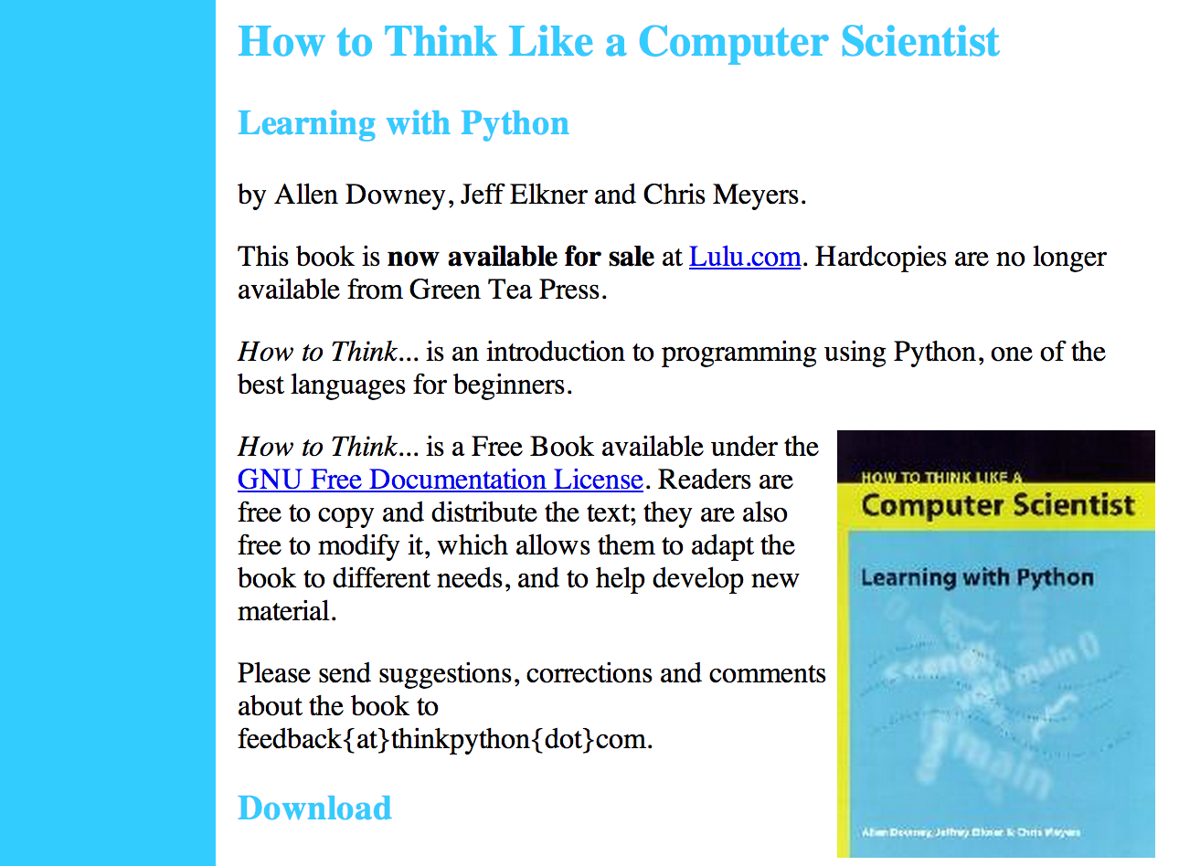

Slide 14
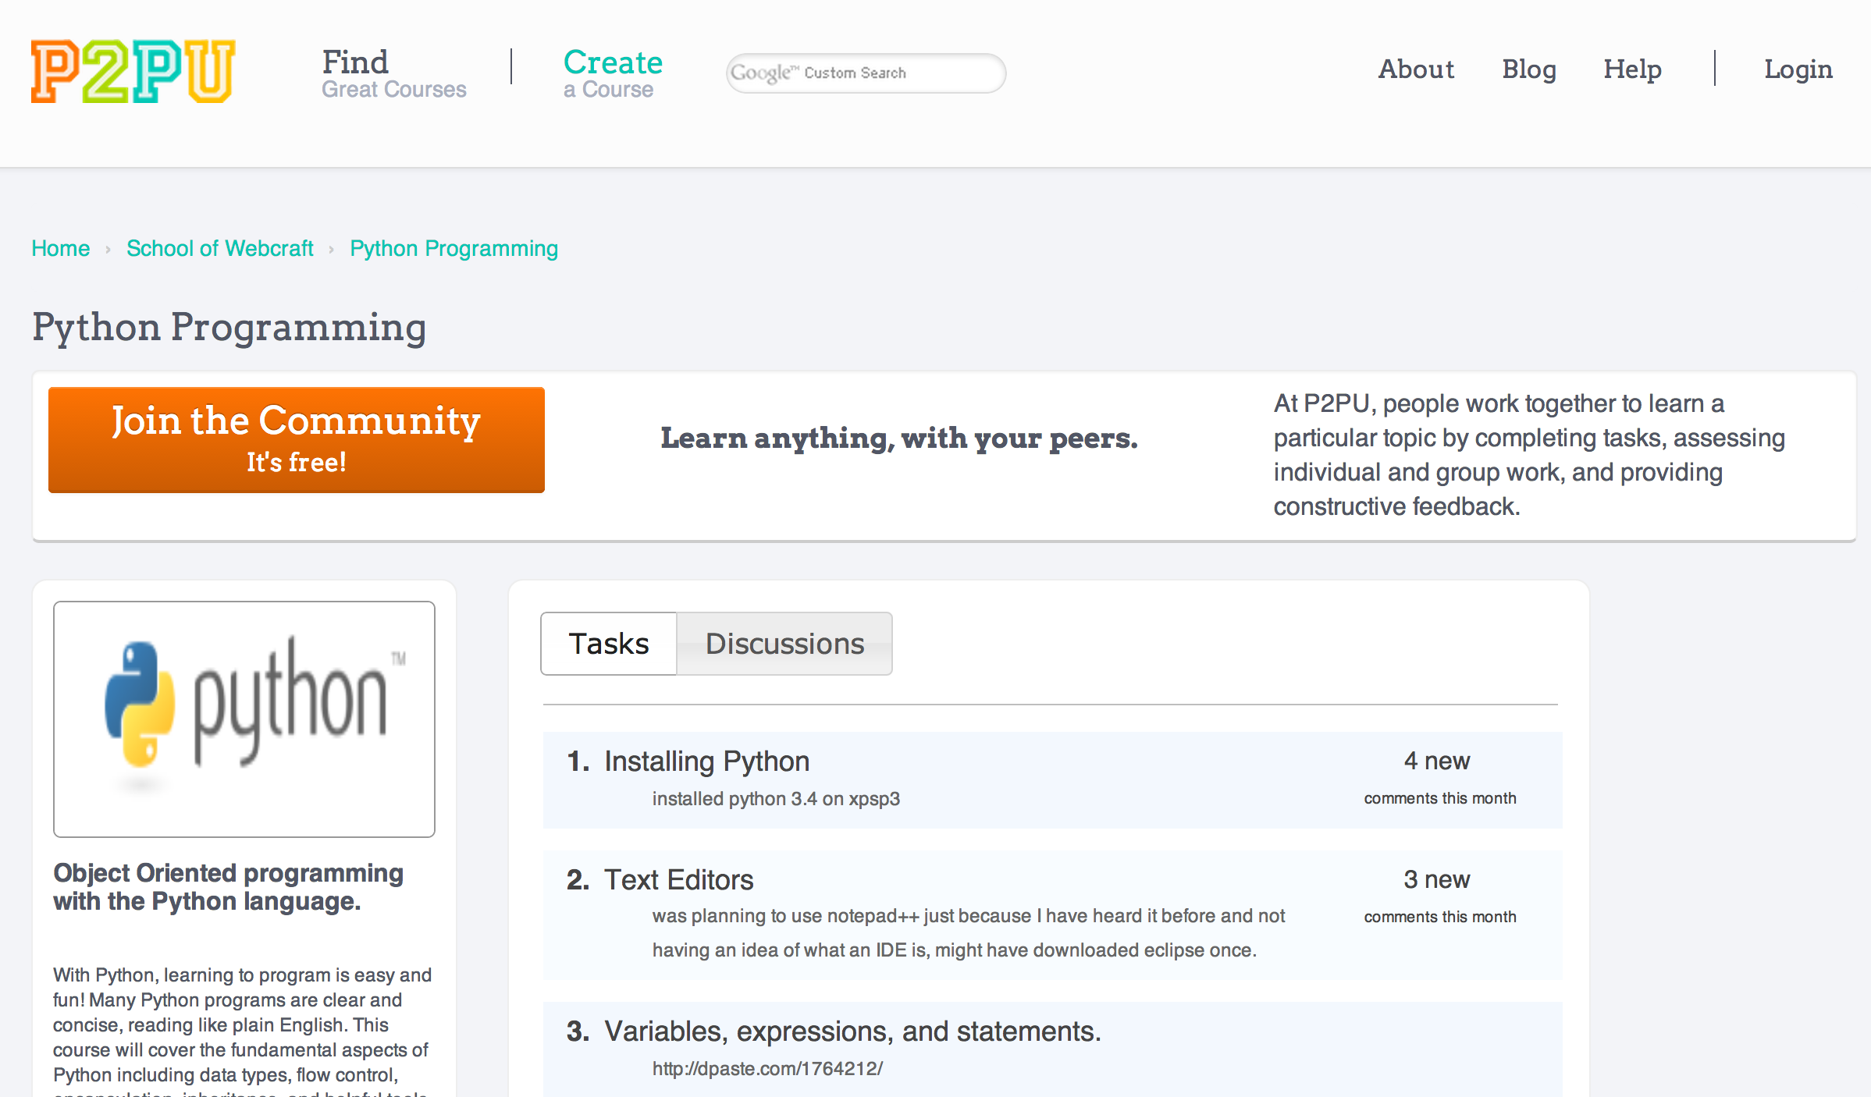

Slide 15
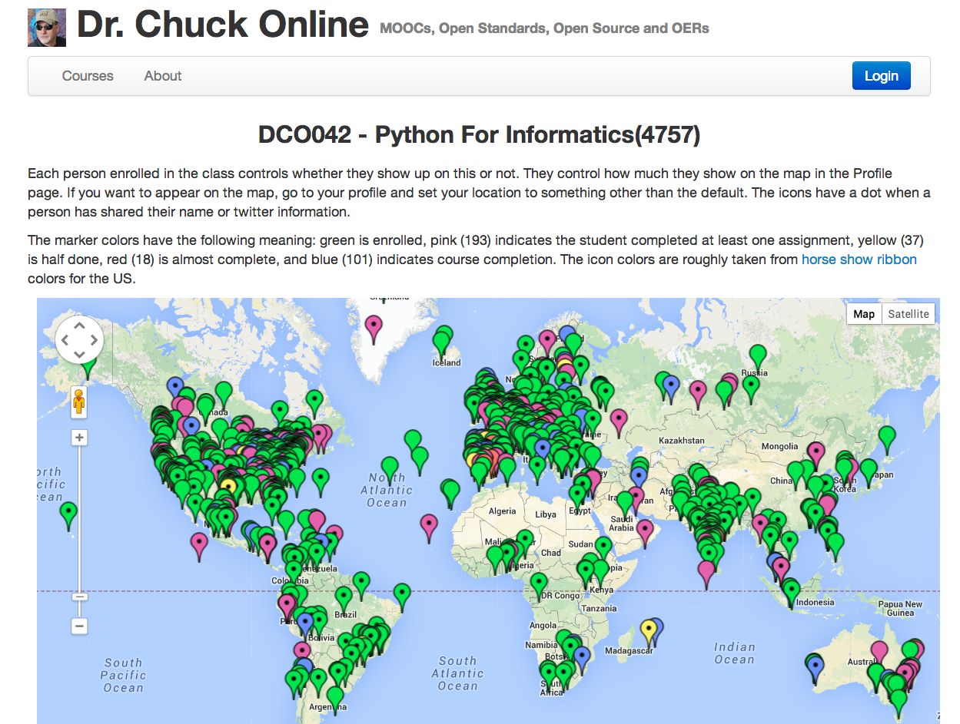

Slide 16
Why non-Free Keeps Winning
Notes:
What is wrong with this picture??

Slide 17
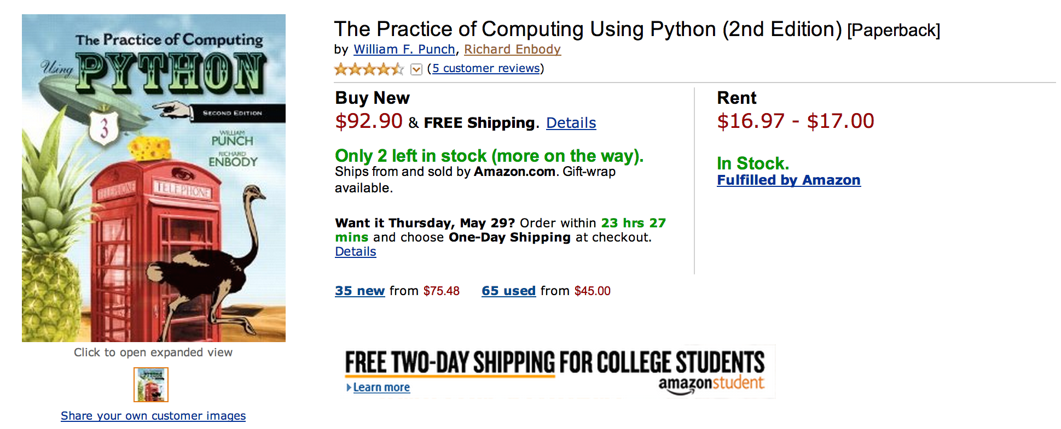
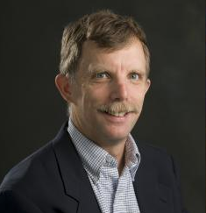
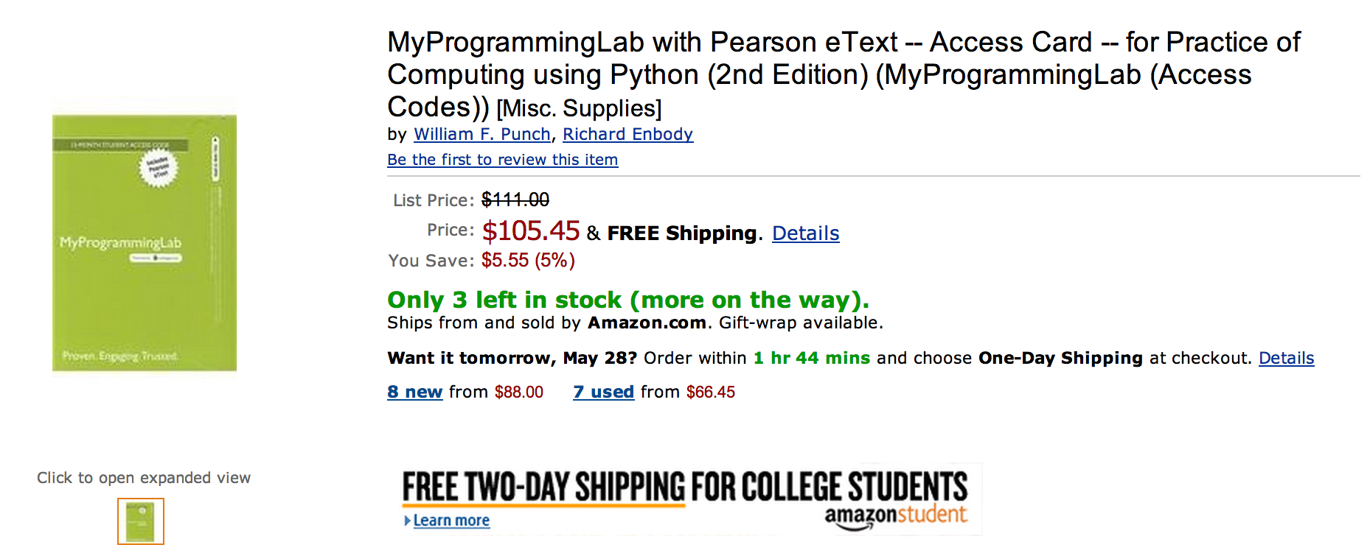

Slide 18
What does $198.35 get you?
Book
Automatic Homework Grading Software
Learning Management System Integration
Instructor Materials
Slides / Solutions Manual / Exams / Course Copy
Instructor Training
3-5 days from notification to full course
Notes:
$65 from Pearson $130 Form bookstore

Slide 19

Teacher Prep
Book
Pearson Value
Proposition
$200
Marketing
Software

Slide 20
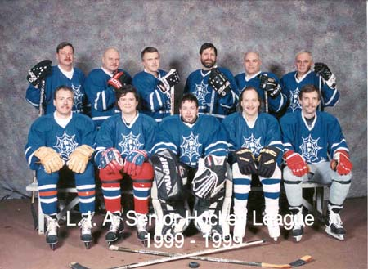
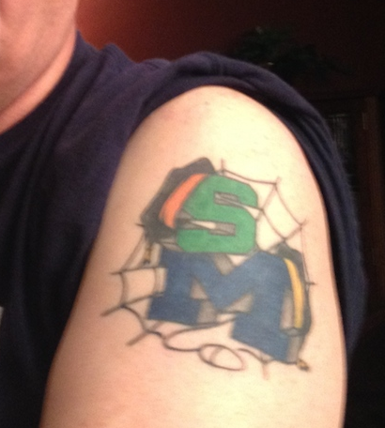

Slide 21
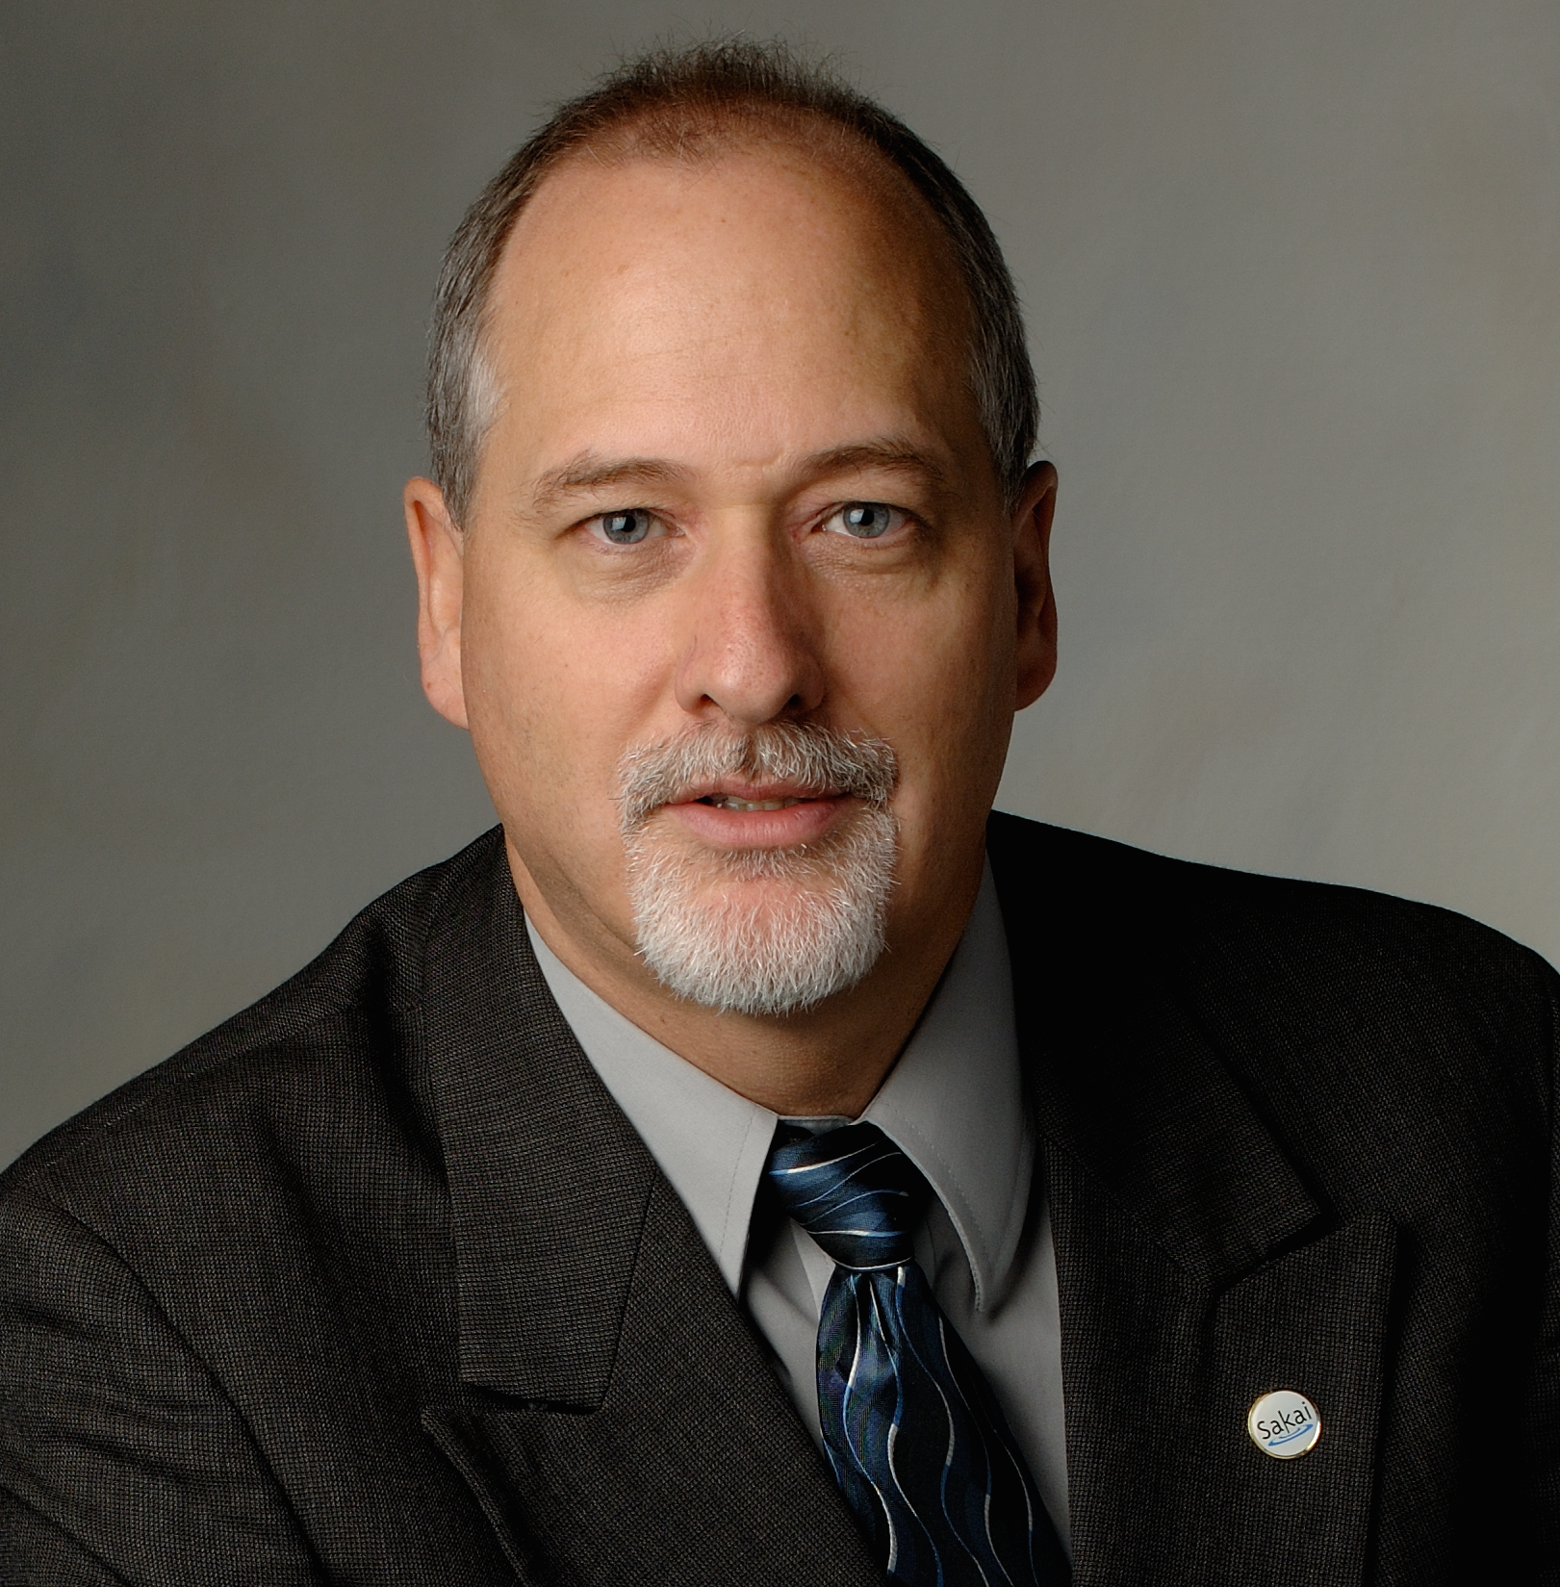
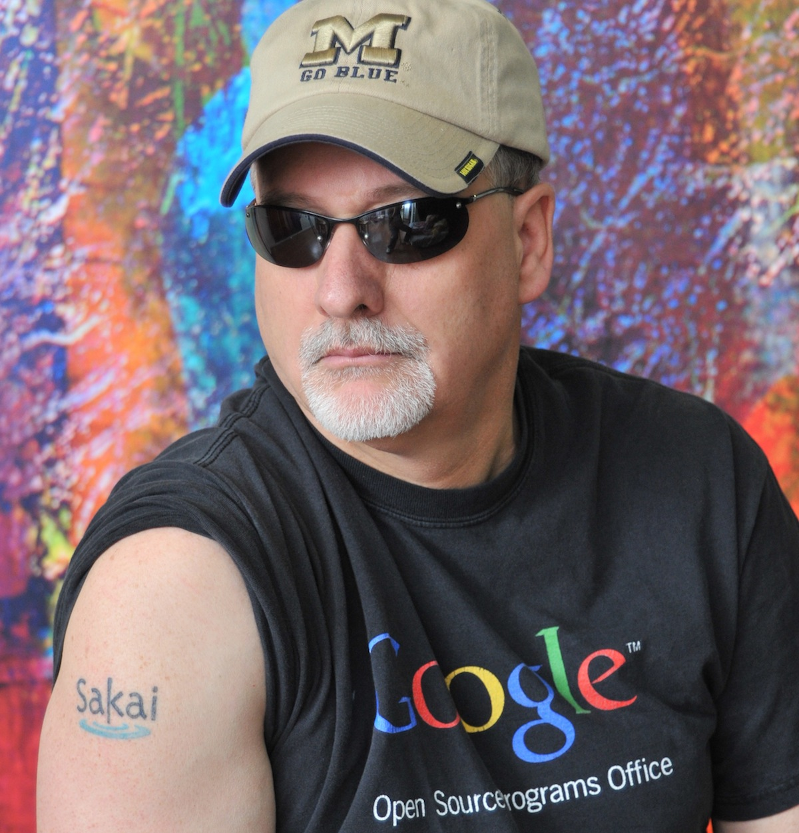
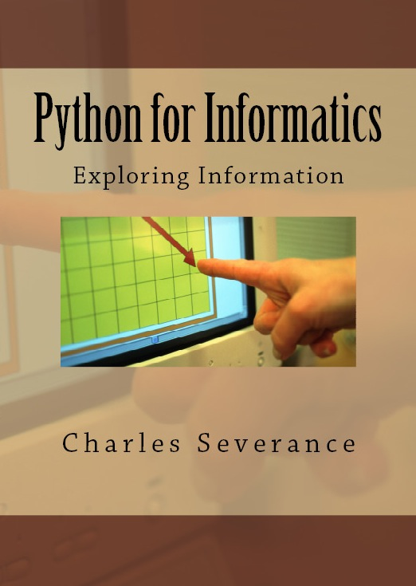



Slide 22
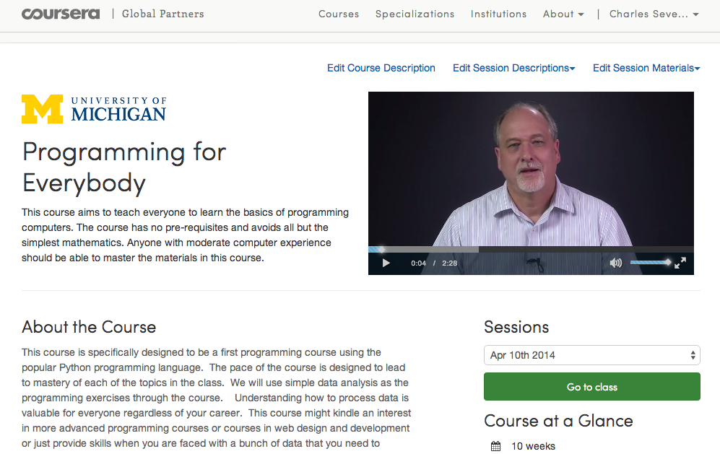

Slide 23
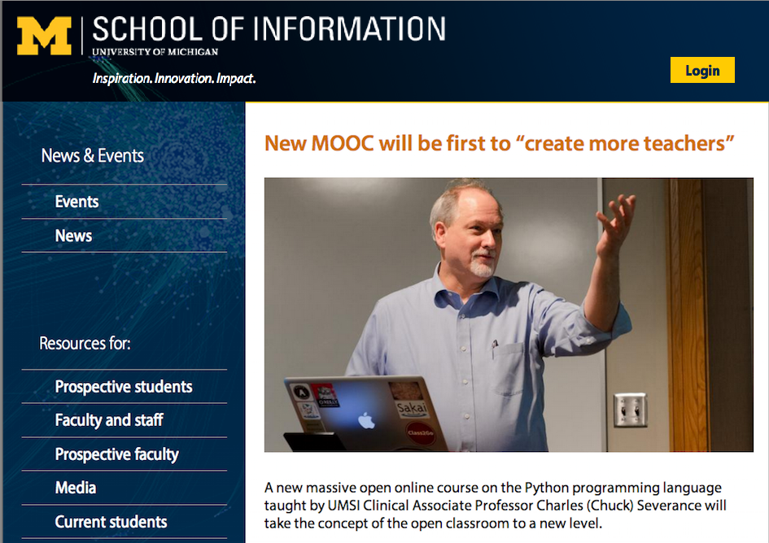

Slide 24
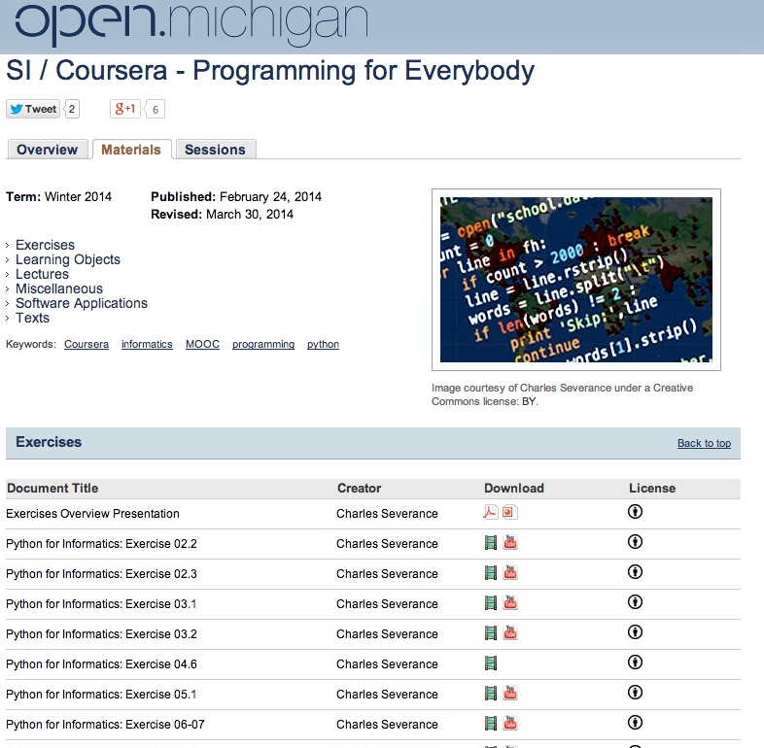

Slide 25
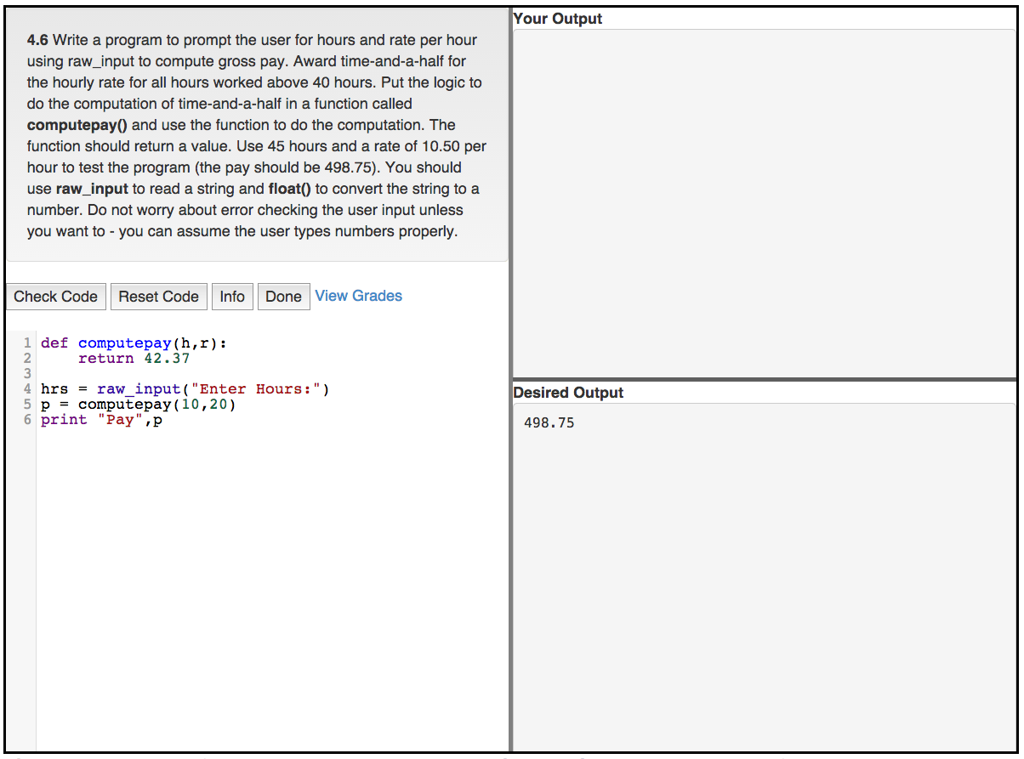

Slide 26
What's Free...
Course Enrollment
Statement of Accomplishment
Book: PDF, MOBI, EPUB, iBooks (CC-BY-NC*)
Lecture Slides in editable form (CC-BY)
Lecture Videos in MP4 or YouTube (CC-BY)
Auto-Grader software integrated into any LMS
* I will remove NC for a legitimate translation

Slide 27
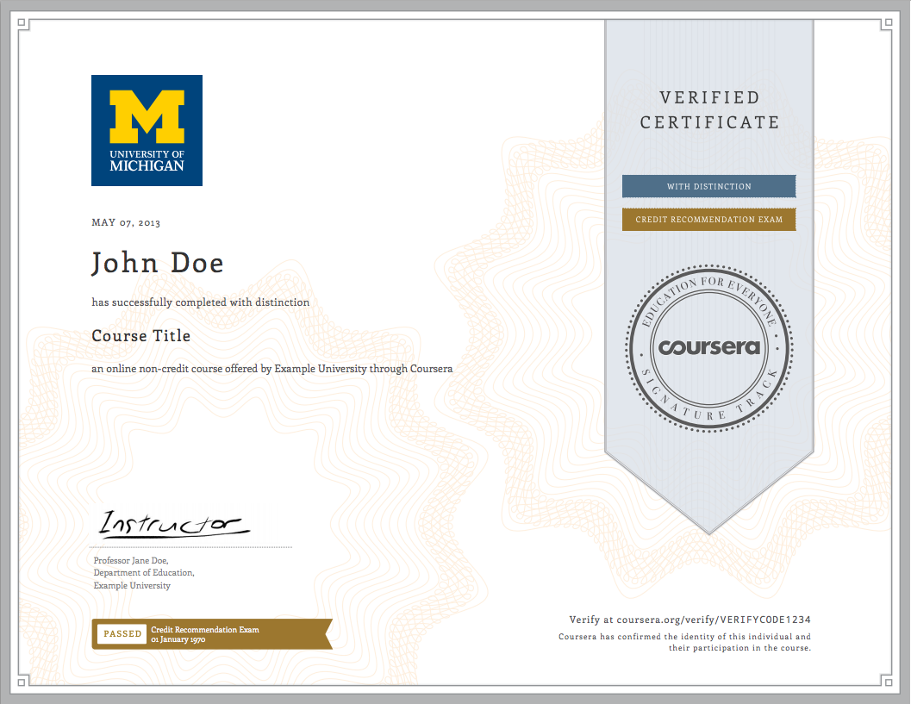
Revenue Model
Print Textbook ($8.99)
Conversion rate 1/200 – Revenue $2.50
Verified Certificates ($40.00)
Conversion rate 1/100 – Revenue $2.00
Session 1: 30497
Session 2: 44843 (1000/day)

Slide 28
My not so hidden agenda.....

Slide 29
In the making...

Slide 30
Teacher Prep
Book
Value
Proposition
Software
Free (or $9)
Marketing
Community
Notes:
Will I get

Slide 31
Inflammatory Remarks...

Slide 32
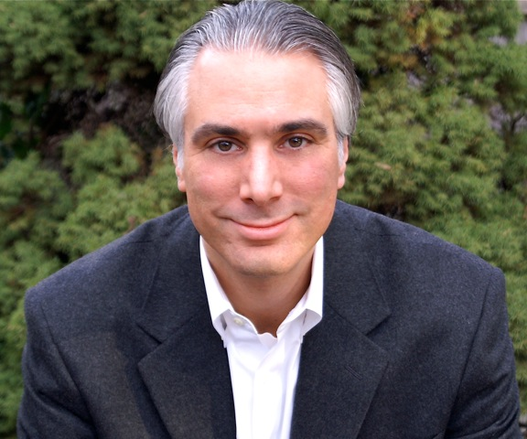
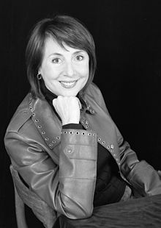




$12.50
$13.08
$18.90
Notes:
Kevin – Wharton Press
Cathy Davidson – Penguin Books - from Duke to CUNY
Scott – Princeton University Press

Slide 33
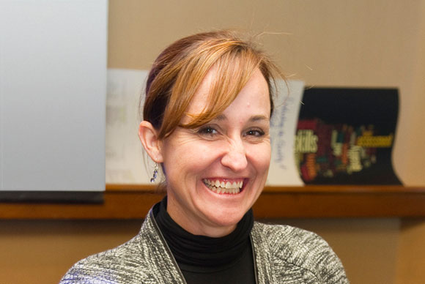
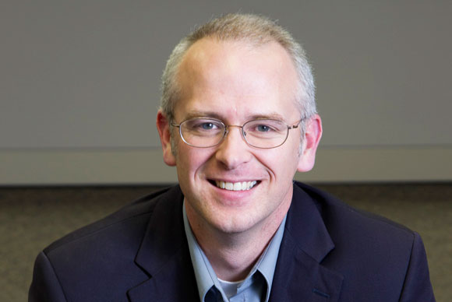
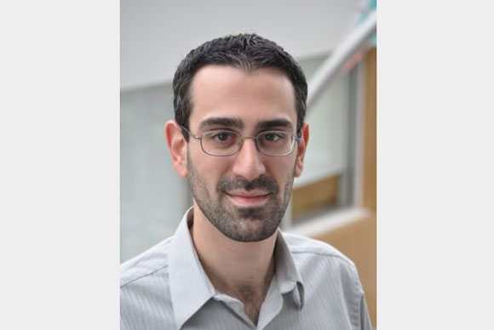
Lumen Learning
#notfail
#warning
Kim Thanos
David Wiley
David Lippman

Slide 34
Learning at Scale is Social
To teach a million students in one class you must connect them with each other dynamically and automatically
Notes:
The software to do this does not exist anywhere and startups claiming "disruption" have no clue at all... Solution: Teachers will be the "inventors"

Slide 35
Universal Connectivity (not)
We need to plan for a teaching environment where every packet costs the end user money
Notes:
Will not happen in our lifetime
Connectivity for "free" applications will get worse not better
Solution: EPUB3 + Very Clever Software

Slide 36
The best ideas are the ones that seem crazy until they are not.
Notes:
At that point it is too late.

Slide 37
Thank you for your time
www.pr4e.org

